Slide 1
Demo of FYP

Slide 2
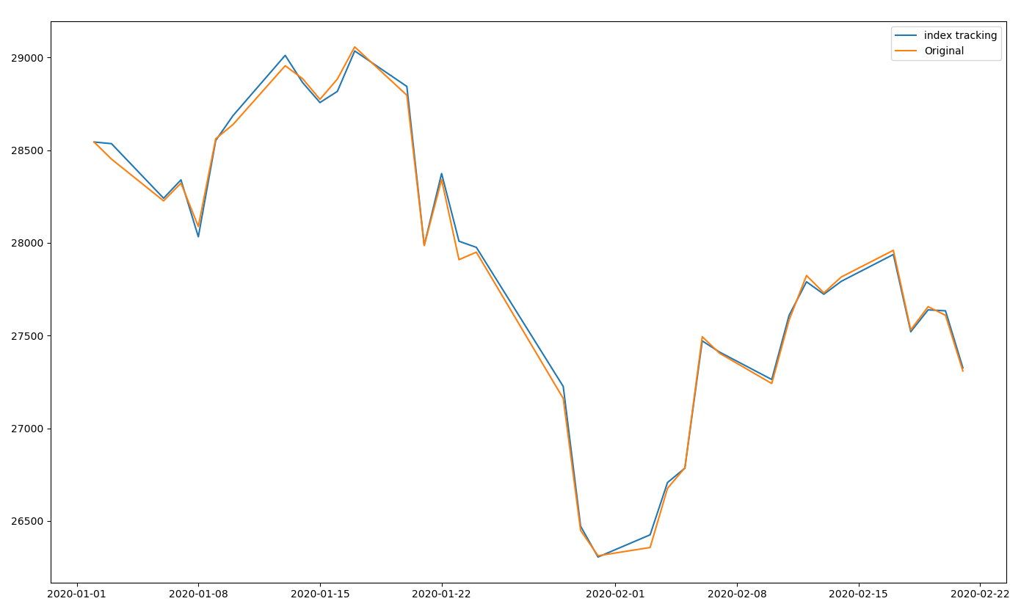
Index tracking result (^HSI)
Tracking index is reduce the 80% stock, blue line is represent the tracking index, and orange line is the original index.

Slide 3
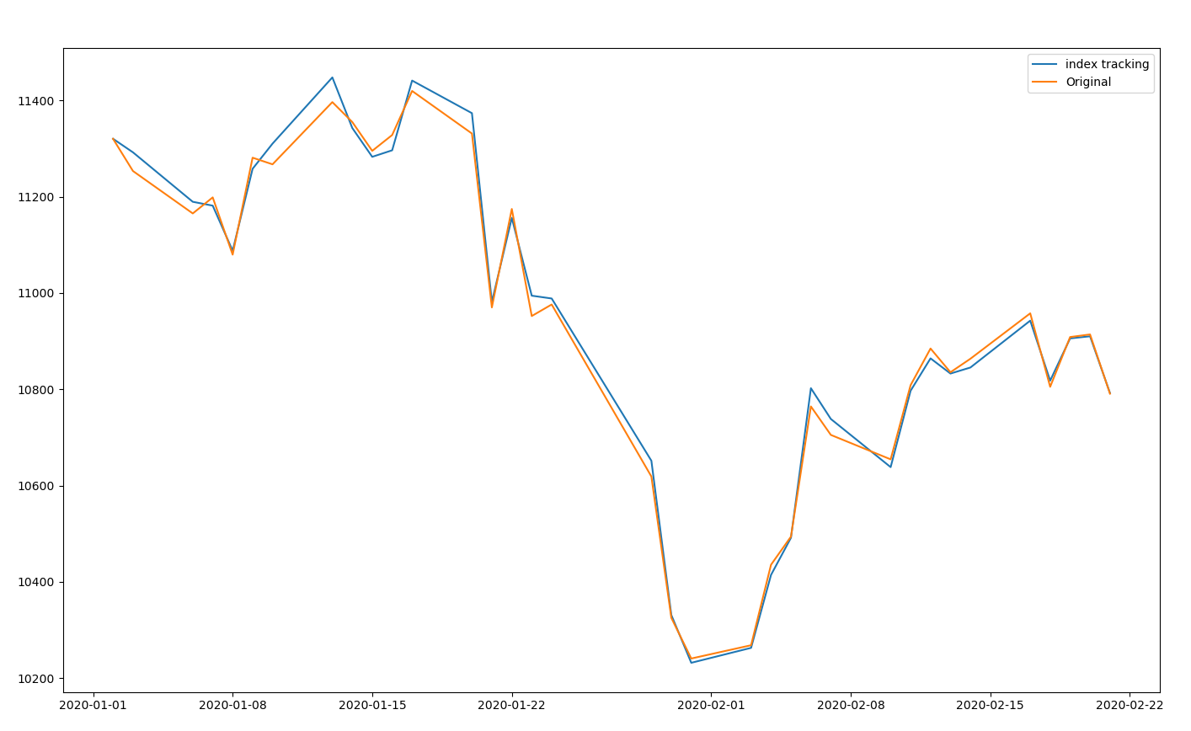
Index tracking result (^HSCE)

Slide 4
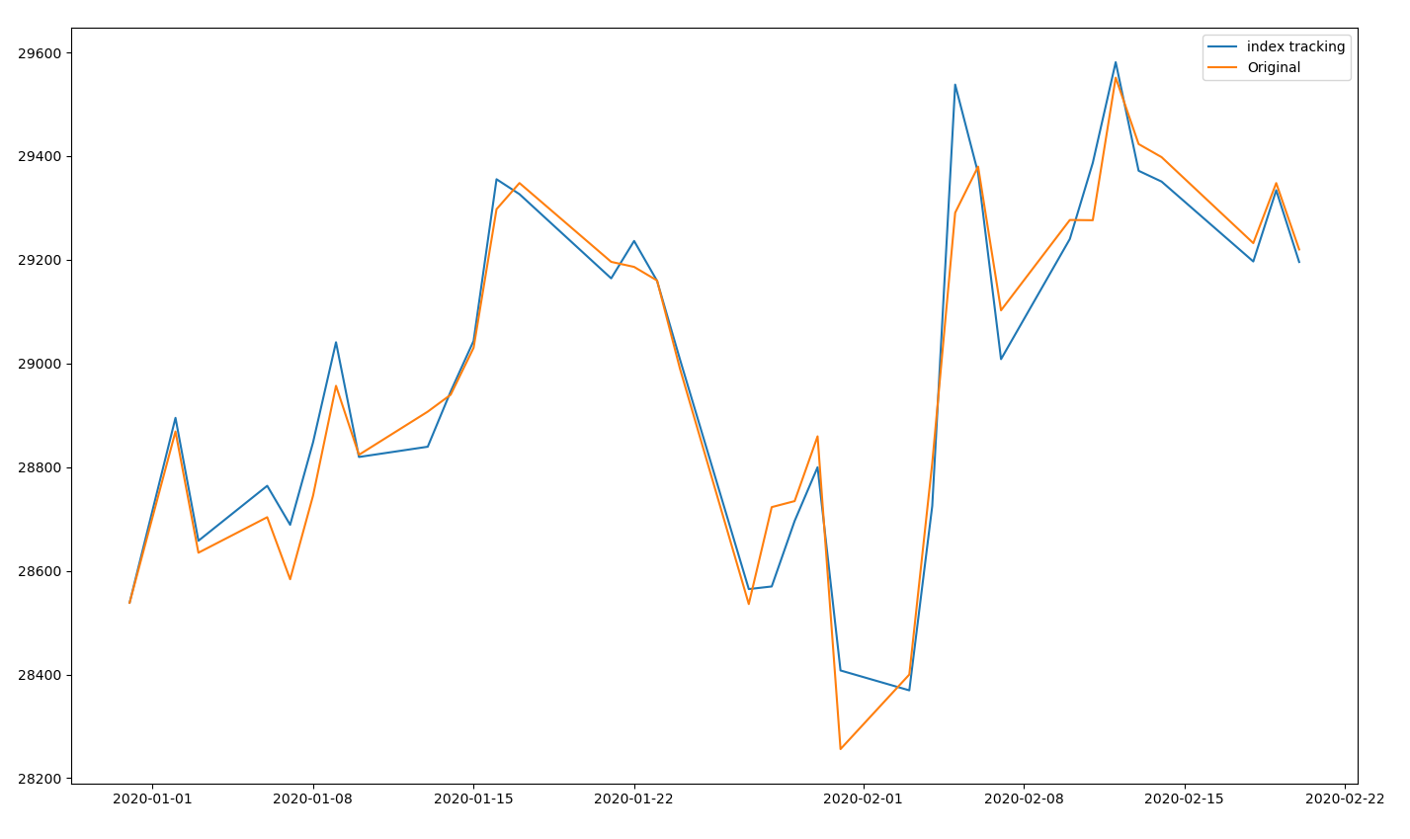
Index tracking result (^DJI)

Slide 5
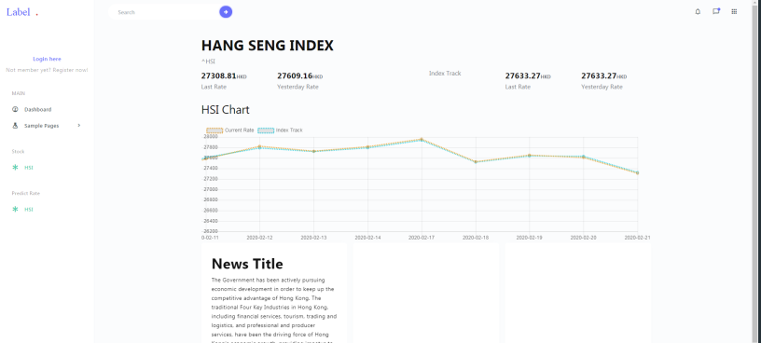
Index tracking UI (Website)
It will display some related news.

Slide 6
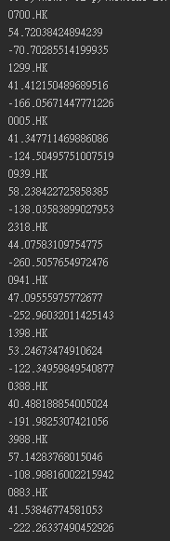
Technical index
This is RSI technical index of each stock.
This is CCI technical index of each stock.

Slide 7

Prediction of the index
The result of the prediction
The prediction is using decision tree to decide the prediction and the max depth of the tree is 10
This 2D array is show about the predict result of the testing data.
The accuracy of the prediction.
Test of AI prediction |  | Decision tree result
 |  | Decrease | Increase
Reality result | Decrease | 195 (predict correct) | 375
 | Increase | 311 | 626(predict correct)

